Slide 1
Chapter 2 Requirements Elicitation and Analysis
Source of PP slides :
- Lamsweerde, A. V. 2011. Requirements Engineering: From System goals to UML Models to Software Specification. 2nd ed.Wiley.
- Weigers, K. And Beatty, J. 2013. Software Requirements. 3rd edn. Microsoft Press.

Slide 2
Lesson objectives:
Identifying stakeholder
Explain Artefact-driven elicitation techniques
Explain Stakeholder-driven elicitation techniques
Understand Requirement Elicitation Process

Slide 3

Stakeholder analysis (1)
Stakeholder cooperation is essential for successful RE
Elicitation = cooperative learning
Representative sample must be selected to ensure adequate, comprehensive coverage of the problem world
dynamic selection as new knowledge is acquired

Slide 4

Stakeholder analysis (2)
Selection of stakeholder based on ...
relevant position in the organization
role in making decisions, reaching agreement
type of contributed knowledge, level of domain expertise
exposure to perceived problems
personal interests, potential conflicts
influence in system acceptance

Slide 5
Knowledge acquisition from stakeholders is difficult (1)
Distributed sources, conflicting viewpoints
Difficult access to key people & data
Different background, terminology, culture
Hidden needs or/and Irrelevant details
Internal politics, competition, resistance to change, ...
Personnel turnover, changes in organization, in priorities, ...

Slide 6

Knowledge acquisition from stakeholders is difficult (2)
Hence, needed:
Communication skills: for talking to, listening from diverse people
Building up Trust relationship
Knowledge reformulation & restructuring (review meetings)

Slide 7


Elicitation Techniques
2 main categories of elicitation techniques:
Artefact-driven elicitation techniques
Stakeholder-driven elicitation techniques

Slide 8
Artefact-driven elicitation techniques
Background study
Data collection, questionnaires
Repertory grids, card sorts for concept acquisition
Scenarios, storyboards for problem world exploration
Prototypes, mock-ups for early feedback
Knowledge reuse: domain-independent, domain-specific

Slide 9
Background study (1)
Collect, read, synthesize documents about...
the organization: organizational charts, business plans, financial reports, meeting minutes, etc
the domain: books, surveys, articles, regulations, reports on similar systems in the same domain
the system-as-is: documented workflows, procedures, business rules; exchanged documents; defect/complaint reports, change requests, etc.

Slide 10
Background study (2)
Provides basics for getting prepared before meeting stakeholders => prerequisite to other techniques
Data mining problem: huge documentation, irrelevant details, outdated info
Solution: use meta-knowledge to prune the doc space
know what you need to know & what you don’t need to know

Slide 11

Data collection
Gather undocumented facts & figures
marketing data, usage statistics, performance figures, costs, ...
selection of representative data sets from available sources (use of statistical sampling techniques)
May complement background study
Helpful for eliciting non-functional reqs on performance, usability, cost etc.
However, difficulties:
Getting reliable data may take time
Data must be correctly interpreted

Slide 12
Questionnaires (1)
Submit a list of questions to selected stakeholders, each with a list of possible answers (+ brief context if needed)
Multiple choice question: one answer to be selected from answer list
Weighting question: list of statements to be weighted...
qualitatively (‘high’, ‘low”, ...), or
quantitatively (percentages)
to express perceived importance, preference, risk etc.

Slide 13
Questionnaires (2)
Effective for acquiring subjective info quickly, cheaply, remotely from many people
Helpful for preparing better focused interviews (see next)
Subject to ...
multiple biases: recipients, respondents, questions, answers
unreliable info: misinterpretation of questions, of answers, inconsistent answers, ....

Slide 14
Questionnaires (3)
Guidelines for questionnaire design and validation:
Select a representative, statistically significant sample of people; provide motivation for responding
Check coverage of questions, of possible answers
Make sure questions, answers, formulations are unbiased & unambiguous
Add implicitly redundant questions to detect inconsistent answers
Have your questionnaire checked by a third party

Slide 15
Card sorts & repertory grids (1)
§ ¨
© ª
Goal: acquire further info about concepts already elicited
Card sort: ask stakeholders to partition a set of cards
Each card captures a concept textually or graphically
Cards grouped into subsets based on stakeholder’s criteria
For each subset, ask questions...
Iterate with same cards for new groupings/properties
Example: meeting scheduling system
Iteration 1: “Meeting”, “Participant” grouped together
=> “participants shall be invited to the meeting”
Iteration 2: “Meeting”, “Participant” grouped together
=> “participant constraints for the meeting must be known”

Slide 16
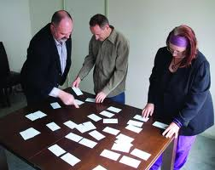
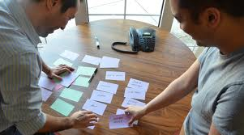
Card sorts

Slide 17
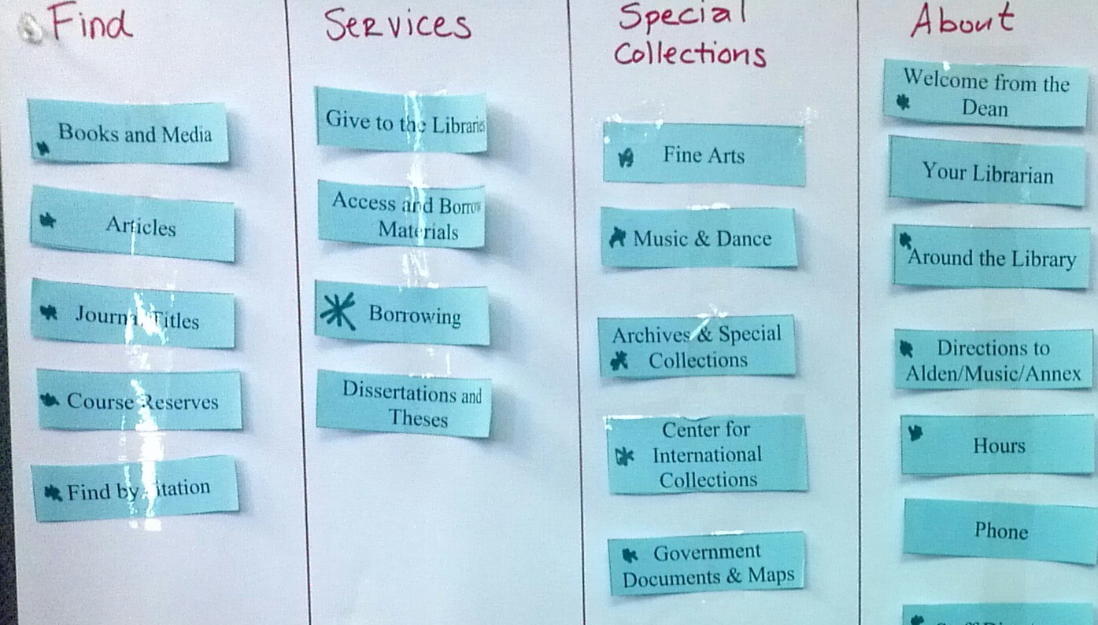
Card sorts

Slide 18
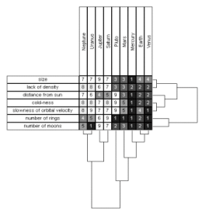
Card sorts & repertory grids (2)
Repertory grid: ask stakeholders to characterize target concept through attributes and value ranges
=> concept-attribute grid
e.g. (Date, Mon-Fri), (Location, Europe)
for grid characterizing Meeting concept
Conceptual laddering: ask stakeholders to classify target concepts along class-subclass links
e.g. subclasses RegularMeeting, OccasionalMeeting of Meeting
J Simple, cheap, easy-to-use techniques for prompt elicitation of missing info
L Results may be subjective, irrelevant, inaccurate

Slide 19
Scenarios & storyboards
Goal: acquire or validate info from concrete examples through narratives ...
how things are running in the system-as-is
how things should be running in the system-to-be
Storyboard: tells a story by a sequence of snapshots
Snapshot = sentence, sketch, slide, picture, etc.
Possibly structured with annotations:
WHO are the players, WHAT happens to them, WHY this happens, WHAT IF this does / does not happen, etc
Passive mode (for validation): stakeholders are told the story
Active mode (for joint exploration): stakeholders contribute

Slide 20
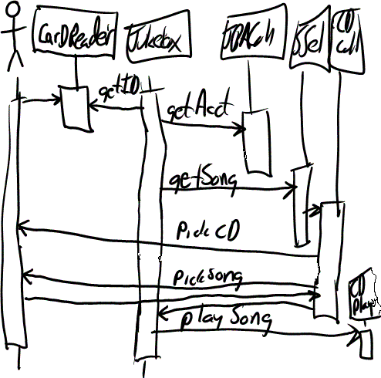
Scenarios
Illustrate typical sequences of interaction among system components to meet an implicit objective
Widely used for...
explanation of system-as-is
exploration of system-to-be + elicitation of further info ...
e.g. WHY this interaction sequence ?
WHY among these components ?
specification of acceptance test cases
Represented by text or diagram

Slide 21
Scenario example: meeting scheduling
1. The initiator asks the scheduler for planning a meeting within some date range. The request includes a list of desired participants.
2. The scheduler checks that the initiator is entitled to do so and that the request is valid. It confirms to the initiator that the requested meeting is initiated.
3. The scheduler asks all participants in the submitted list to send their date and location constraints back within the prescribed date range.
4. When a participant returns her constraints, the scheduler validates them (e.g., with respect to the prescribed date range). It confirms to the participant that the constraints have been safely received.
5. Once all valid constraints are received, the scheduler determines a meeting date and location that fit them.
6. The scheduler notifies the scheduled meeting date and location to the initiator and to all invited participants

Slide 22
Types of scenario
Positive scenario = one behavior the system should cover (example)
Negative scenario = one behavior the system should exclude (counter-example), e.g.
1. A participant returns a list of constraints covering all dates within the given date range
2. The scheduler forwards this message to all participants asking them for alternative constraints within extended date range
Normal scenario: everything proceeds as expected
Abnormal scenario = a desired interaction sequence in exception situation (still positive)
e.g. meeting initiator not authorized
participant constraints not valid

Slide 23
Scenarios: pros & cons
J Concrete examples/counter-examples
J Narrative style (appealing to stakeholders)
J Yield animation sequences, acceptance test cases
L Inherently partial (-test coverage problem)
L Potential over specification: unnecessary sequencing, premature software-environment boundary
L May contain irrelevant details, incompatible granularities from different stakeholders
Concrete scenarios naturally jump in anyway...
Invaluable as initial elicitation vehicles

Slide 24
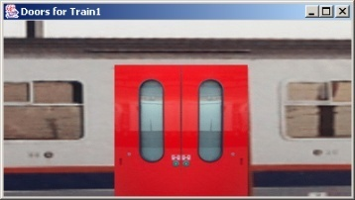
Prototypes & mock-ups
Goal: check req adequacy from direct user feedback, by showing reduced sketch of software-to-be in action
focus on unclear, hard-to-formulate reqs to elicit further
Prototype = quick implementation of some aspects ...
Functional proto: focus on specific functional reqs
e.g. initiating meeting, gathering participant constraints
User interface proto: focus on usability by showing input-output forms, dialog patterns
e.g. static/dynamic interaction to get participant constraints
Quick implementation: by use of very high-level programming language, executable spec language, generic services, ...

Slide 25
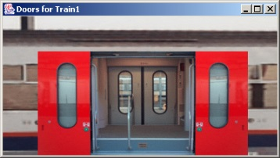
Requirements prototyping
Elaborate
requirements
Prototype
requirements
Demonstrate proto
& get feedback
[ not Proto_OK ]
[ Proto_OK ]
…
Mock-up: proto is thrown away (product = adequate reqs)
Evolutionary proto: transformed towards efficient code

Slide 26

Prototypes & mock-ups: pros & cons
J Concrete flavor of what the software will look like
=> clarify reqs, elicit hidden ones, improve adequacy, understand implications, ...
J Other uses: user training, integration testing, ...
L Does not cover all aspects
missing functionalities
ignores important non-functional reqs (performance, cost, ...)
L Can be misleading, set expectations too high
L ‘Quick-and-dirty’ code, hard to reuse for sw development
L Potential inconsistencies between modified code and documented requirements

Slide 27
Knowledge reuse
Goal: speed up elicitation by reuse of knowledge from experience with related systems
Eg: knowledge about similar organization, domain, problem world: requirements, assumptions, ...
General reuse process:
1. RETRIEVE relevant knowledge from other systems
2. TRANSPOSE it to the target system
3. VALIDATE the result, ADAPT it if necessary & INTEGRATE it with the system knowledge already acquired
Transposition mechanisms:
instantiation (memberOf)
specialization (subClassOf) + feature inheritance
reformulation in vocabulary of target system

Slide 28
Reuse of domain-independent knowledge: requirements taxonomies
For each leaf node in available req taxonomies:
“Is there any system-specific req instance from this class?”
More specific taxonomy => more focussed search
response time for ...
participant constraints ?
meeting scheduling ?
meeting notification ?
mean number of meetings to
be scheduled at peak times ?

Slide 29
Reuse of domain-independent knowledge: RD meta-model
RD meta-model = concepts & relationships in terms of which RD items are captured
Elicitation by meta-model traversal
RD items are acquired as instantiations of meta-model items

Slide 30
Reuse of domain-specific knowledge
Abstract domain = concepts, tasks, actors, objectives, reqs, domain properties abstracting from a class of domains
RD items acquired as specializations of abstract items to target system (feature inheritance + system-specific renaming)
Spec inheritance
“A user may not use more than X resource units at a time”
“A patron may not borrow more than X book copies at a time”

Slide 31
Reuse of domain-specific knowledge (2)
Same abstract domain may have multiple specializations
e.g. resource management <-- library loan management,
videostore management, flight or concert seat allocation,...
Same concrete domain may specialize multiple abstract domains
e.g. library management:
loan management --> resource management
book acquisition --> e-shopping
patron registration --> group membership management
More adequate RD items elicited by reuse of more structured, more accurate abstract domains
e.g. resource management: returnable vs. consumable resource
sharable vs. non-sharable resource
=> “A book copy can be borrowed by one patron at a time”

Slide 32

Knowledge reuse: pros & cons
J Expert analysts naturally reuse from past experience
J Significant guidance and reduction of elicitation efforts
J Inheritance of structure & quality of abstract domain spec
J Effective for completing RD with overlooked aspects
L Effective only if abstract domain sufficiently “close”, accurate
L Defining abstract domains for significant reusability is hard
L Validation & integration efforts
L Near-matches may require tricky adaptations

Slide 33
Stakeholder-driven elicitation techniques
Interviews
Observation and ethnographic studies
Group sessions

Slide 34
Interviews
Primary technique for knowledge elicitation
1. Select stakeholder specifically for info to be acquired
(domain expert, manager, salesperson, end-user, consultant, ...)
2. Organize meeting with interviewee, ask questions, record answers
3. Write report from interview transcripts
4. Submit report to interviewee for validation & refinement
Single interview may involve multiple stakeholders
J saves times
weaker contact; individuals less involved, speak less freely
Interview effectiveness:
(utility x coverage of acquired info) / acquisition time

Slide 35
Types of interview
Structured interview: predetermined set of questions
specific to purpose of interview
some open-ended, others with pre-determined answer set
more focussed discussion, no rambling among topics
Unstructured interview: no predetermined set of questions
free discussion about system-as-is, perceived problems, proposed solutions
exploration of possibly overlooked issues
=> Effective interviews should mix both modes ...
start with structured parts
shift to unstructured parts as felt necessary

Slide 36
Interviews: strengths & difficulties
J May reveal info not acquired through other techniques
how things are running really, personal complaints, suggestions for improvement, ...
J On-the-fly acquisition of info appearing relevant
new questions triggered from previous answers
L Acquired info might be subjective (hard to assess)
L Potential inconsistencies between different interviewees
L Effectiveness critically relies on interviewer’s attitude, appropriateness of questions

Slide 37

Guidelines for effective interviews (1)
Identify the right interviewee sample for full coverage of issues
different responsibilities, expertise, tasks, exposure to problems
Come prepared, to focus on right issue at right time
backgound study first
predesign a sequence of questions for this interviewee
Centre the interview on the interviewee’s work & concerns
Keep control over the interview
Make the interviewee feel comfortable
Start: break ice, provide motivation, ask easy questions
Consider the person too, not only the role
Do always appear as a trustworthy partner

Slide 38

Guidelines for effective interviews (2)
Be focused, keep open-ended questions for the end
Be open-minded, flexible in case of unexpected answers
Ask why-questions without being offending
Avoid certain types of questions ...
opinioted or biased
affirmative
obvious or impossible answer for this interviewee
Edit & structure interview transcripts while still fresh in mind
including personal reactions, attitudes, etc
Keep interviewee in the loop
co-review interview transcript for validation & refinement

Slide 39
Observation & ethnographic studies
Focus on task elicitation in the system-as-is
Understanding a task is often easier by observing people performing it (rather than verbal or textual explanation)
Passive observation: no interference with task performers
Watch from outside, record (notes, video), edit transcripts, interpret
Protocol analysis: task performers concurrently explain it
Ethnographic studies: over long periods of time, try to discover emergent properties of social group involved
about task performance + attitudes, reactions, gestures, ...
Active observation: you get involved in the task, even become a team member

Slide 40
Observation & ethnographic studies: pros & cons
J May reveal ...
tacit knowledge that would not emerge otherwise
e.g. ethnographic study of air traffic control => implicit mental
model of air traffic to be preserved in system-to-be
hidden problems through tricky ways of doing things
culture-specific aspects to be taken into account
Contextualization of acquired info
L Slow & expensive: to be done over long periods of time, at different times, under different workload conditions
L Potentially inaccurate (people behave differently when observed)
L Data mining problem, interpretation problem
L Focus on system-as-is

Slide 41

Group sessions
More perception, judgement, invention from interactions within group of diverse people
Elicitation takes place in series of group workshops (a few days each) + follow-up actions
audiovisuals, wall charts to foster discussion, record outcome
Structured group sessions:
Each participant has a clearly defined role
(leader, moderator, manager, user, developer, ...)
Contributes to req elaboration according to his/her role, towards reaching synergies
Generally focused on high-level reqs
Variants: focus groups, Joint Application Development(JAD), Quality Function Deployment(QFD), ...

Slide 42
Group sessions (2)
Unstructured group sessions (brainstorming):
Participants have a less clearly defined role
Two separate stages ...
1. Idea generation to address a problem:
as many ideas as possible from each participant without censorship/criticism
2. Idea evaluation:
by all participants together according to agreed criteria (e.g. value, cost, feasibility) to prioritize ideas

Slide 43
Group sessions: pros & cons
J Less formal interactions than interviews
=> may reveal hidden aspects of the system (as-is or to-be)
J Potentially ...
wider exploration of issues & ideas
more inventive ways of addressing problems
J Synergies => agreed conflict resolutions
L Group composition is critical ...
time consuming for key, busy people
heavily relying on leader expertise & skills
group dynamics, dominant persons => biases, inadequacies
L Risk of ...
missing focus & structure => rambling discussions, little concrete outcome, waste of time
superficial coverage of more technical issues

Slide 44

Combining techniques
Elicitation techniques have complementary strengths & limitations
Strength-based combinations are more effective for full, adequate coverage
artefact-driven + stakeholder-driven
Examples
Contextual Inquiry: workplace observation + open-ended interviews + prototyping
RAD: JAD group sessions + evolutionary prototyping (with code generation tools)
Techniques from other RE phases support elicitation too
Resolution of conflicts, risks, omissions, etc.

Slide 45
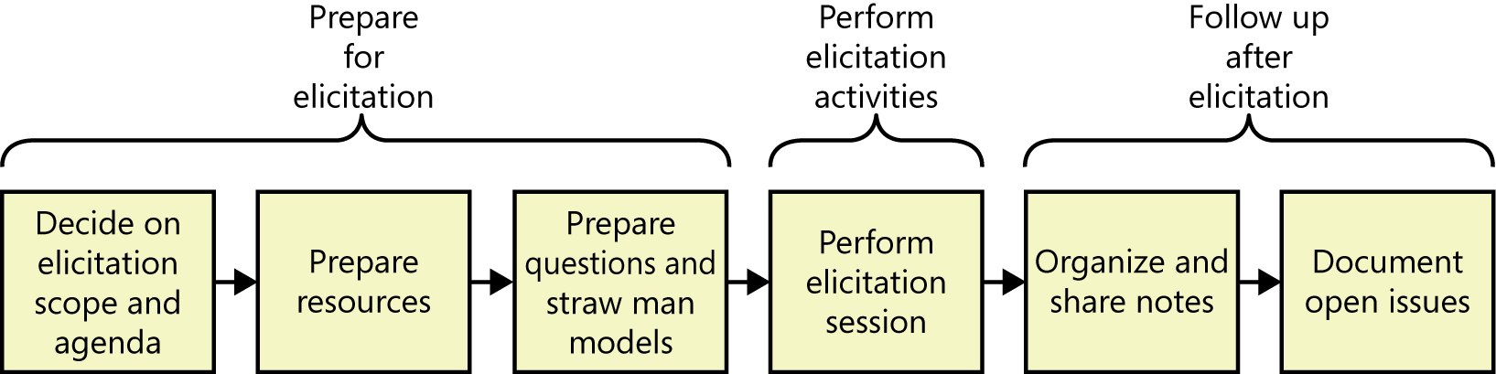
Requirements Elicitation Process
FIGURE A : Activities for a single requirements elicitation session.
(Source : Weigers, K. And Beatty, J. 2013. Software Requirements. 3rd edn. Microsoft Press)

Slide 46
Requirements Elicitation Process
Preparing for elicitation
i)Plan on the scope and agenda
Decide on scope, align the scope of elicitation with overall project scope
itemize the agenda in topics
Taking account the available time
ii)Prepare resources
Identify relevant stakeholders and learn about them
Schedule physical resources (room, equipment etc), participants, collect various documents, learn about existing system etc

Slide 47
Requirements Elicitation Process
Preparing for elicitation (cont’)
iii) Prepare questions and straw man model
Prepare a set of relevant questions
Ask different type of question for different situation, eg: open-ended question to help understand current system process and to see how the new system could improve the performance
Analysis models can be used to help provide better requirements
Some of the useful models are use case model, activity diagram etc
Create straw man models or draft models ahead of your elicitation sessions
Straw man model serves as a starting point that helps you learn about the topic

Slide 48
Requirements Elicitation Process
Performing elicitation
-Executing the elicitation activity : interview, observation, documentation reviews etc
-Useful tips for performing elicitation:
Educate stakeholders
Take good notes
Exploit the physical space

Slide 49
Requirements Elicitation Process
Following up after elicitation
i) Organizing and sharing the notes
Consolidate the inputs from multiples sources through various elicitation techniques
Keep a set of raw notes to refer later if necessary after editing the notes
Share the notes to participants for reviewing
Share the notes with other stakeholders to flag any issues
ii) Document open issues
Items that need to be further explored, knowledge gap that you need to close, new questions while reviewing your notes etc
Record them in a issue-tracking tool - to record the relevant notes, progress already made, owner, due date etc

Slide 50
ANY QUESTION…

